Slide 1
Crowd sourcing & Crowd DB
By:
Muhammad Umer Adeem (02-131192-044)
Sajjad Ahmed (02-131192-052)
Muhammad Ishaq (02-235172-001)

Slide 2
The Problem
Some queries cannot be answered by machines only.
Processing such queries requires human input for providing information that is missing from the database, for performing computationally difficult functions, and for matching, ranking, or aggregating results based on fuzzy criteria.
For Example, these queries would require Human Interaction:
Given a university and department name, find the link to department webpage.
Among provided pictures, which picture is visualized better.
Similarly, there are many queries that can’t be answered alone by the computer.

Slide 3
Crowd Sourcing
Crowdsourcing involves a large group of dispersed participants contributing or producing goods or services for payment or as volunteers.
Two main human capabilities that allow correctness in crowdsourcing:
Finding new data
Comparing data
When to Crowd Source:
Computers cannot do the task (e.g., translation)
A single person cannot do the task
The work can be split into many small tasks

Slide 4
Crowd Sourcing
The Components in Crowd Sourcing:
Requester: People who submit tasks and collect answers
Platform: Performs task management
Worker: People who work on tasks
Process of Crowd Sourcing:
A requester has work to be done.
The problem is broadcast online.
Crowd is asked for a solution.
Crowd reply their solutions.
Requesters approve or reject.
Requesters pay the pre-defined reward.

Slide 5
Crowd Sourcing
Examples of Crowd Sourcing Platforms:
Most Famous: Wikipedia
Mechanical Turk: Marketplace for (usually small) tasks
Crowd DB: Uses crowd to answer DB queries

Slide 6
Hybrid Human Machine DBMS
Hard Database Problems
Missing Data: A key limitation of relational technology stems from the Closed World Assumption. People, aided by tools such as search engines and reference sources, are quite capable of finding information that they do not have readily at hand.
Fuzzy Comparisons: People are skilled at making comparisons that are difficult or impossible to encode in a computer algorithm
Harness Human Computation for solving problems that are impossible or too expensive to answer correctly using computers.
Is it possible leverage such human resources to extend the capabilities of database systems?

Slide 7
Crowd DB
Crowd DB uses human input via crowdsourcing to process queries that neither database systems nor search engines can adequately answer.
It uses SQL both as a language for posing complex queries and to model data.
Leverages the best from both sides
Human power for comparing and finding data
Machine power for heavy computation
Automatic task assignment

Slide 8
Crowd DB Design Considerations
Performance and variability
Work speed
Work cost
Work quality
Task design and ambiguity
Natural language ambiguity
UI Design

Slide 9
Crowd DB Design Considerations
Affinity and learning
Workers develop skills, and relationships with requesters.
Relatively small worker Pool
Impact in parallelism and throughput
Open vs. closed world
Possible return unlimited number of answers.

Slide 10
Crowd DB Advantages
Unexpected solutions to tough problems.
A greater diversity of thinking to solve a query.
A reduced management burden, due to the use of crowdsourcing platforms and automaticity.
Faster problem solving
A rich source of customer data can be gathered.
Database is ever expanding.
Crowdsourcing saves costs and time

Slide 11
Crowd DB Problems
Loss of Confidentiality and intellectual property.
Less control over the process.
Risk of inconsistent outcomes.
Poor quality entries.

Slide 12
Crowd SQL
Superset of SQL
With minimal extension to support crowdsourcing
Expressive semantics
Incomplete data
Crowdsource new column/record if not exist
Subjective comparisons
Compare/order values
Crowd SQL changes the closed-world to an open-world assumption

Slide 13
Crowd SQL Incomplete Data
Two scenarios:
Specific attributes could be crowdsourced
Entire tuples could be crowdsourced
Introduce a CROWD keyword to solve both.
Specific attributes | Entire tuples
CREATE TABLE Department ( university STRING, name STRING, url CROWD STRING, phone STRING, PRIMARY KEY (university, name) ); | CREATE CROWD TABLE Professor ( name STRING PRIMARY KEY, email STRING UNIQUE, university STRING, department STRING, FOREIGN KEY (university, department) REF Department(university, name) );

Slide 14
Crowd SQL Incomplete Data
A special CNULL value indicates data in CROWD columns that should be crowd-sourced when needed as part of processing a query.
During INSERT/UPDATE, crowd columns can also be initialized.
All non-initialized crowd columns are set to CNULL.
INSERT INTO Department(university, name) VALUES ("UC Berkeley", "EECS");
Consider example above, it sets url to CNULL

Slide 15
Crowd SQL Incomplete Data
Crowd DB supports any kind of SQL query on CROWD tables and columns.
Let us take two examples based on the tables created previously:
SELECT url FROM Department WHERE name = "Math";
In this, the url column would be implicitly updated with the crowdsourced URL.
SELECT * FROM Professor WHERE email LIKE "%berkeley%" AND dept = "Math";
In this query missing values in the email column would be implicitly populated and new professors of math department would be implicitly inserted as a side-effect of processing.

Slide 16
Crowd SQL Comparisons
Beyond finding missing data, subjective comparisons is an important use of Crowd DB
Two new operators: CROWDEQUAL and CROWDORDER
CROWDEQUAL(~=) takes two parameters (lvalue and rvalue) and asks the crowd to decide whether the two values are equal
SELECT * FROM department WHERE name ~= "CS";
Here the query writer asks the crowd to do entity resolution with the possibly that different names given for Computer Science in the database like 'Computer Science', 'CSE', etc.

Slide 17
Crowd SQL Comparisons
CROWDORDER is used whenever the help of the crowd is needed to rank or order results
The Crowd SQL query below asks for a ranking of pictures regarding how well these pictures depict the Golden Gate Bridge.
CREATE TABLE picture ( p IMAGE, subject STRING );
SELECT p FROM picture WHERE subject = "Golden Gate Bridge" ORDER BY CROWDORDER(p, "Which picture visualizes better %subject");
As with missing data, CrowdDB stores the results of CROWDEQUAL and CROWDORDER calls so that the crowd is only asked once for each comparison. This caching is equivalent to the caching of expensive functions in traditional SQL databases

Slide 18
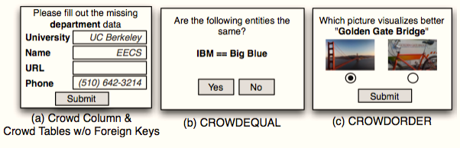
Crowd DB UI Generation
A clear, unambiguous user interface helps greatly in improving accuracy.
Two step process:
Compile-time : Crowd DB creates templates to crowd-source missing information from all CROWD tables and all regular tables which have CROWD columns. JS is generated in addition to HTML to do type checking.
Runtime: These templates are instantiated at runtime in order to provide a user interface for a concrete tuple or a set of tuples.

Slide 19
Crowd DB Optimizer
Optimizer handles crowd operators.
As, CPU time taken << time taken by crowd to answer
So, Goal of optimizer is to find plan which results in least number of queries to Crowd.
The following optimizations are used:
Batching:
Get information of several tuples at once (Eg: URL of Elec, CS, EP of UC-Berkeley).
Assumption: cheaper to input two pieces of information of the same kind in a single form rather than separate forms.
Prefetching:
Consider, say both the department and email of a professor are unknown, but only the email of that professor is required to process a query, it might make sense to get the department too.

Slide 20
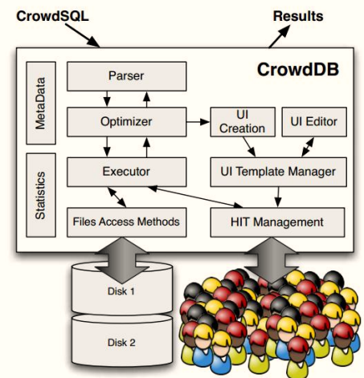
Crowd DB - Architecture

Slide 21
THE END

